Slide 1
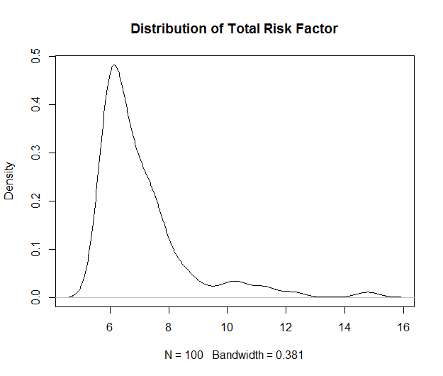
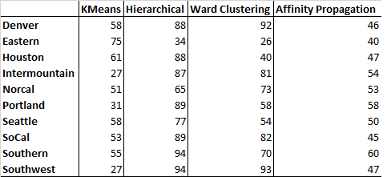
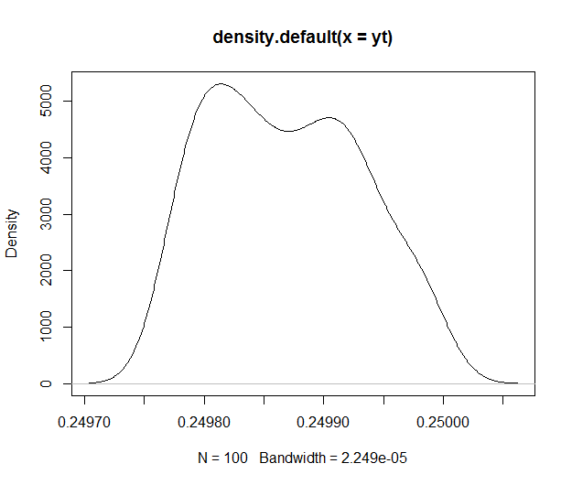
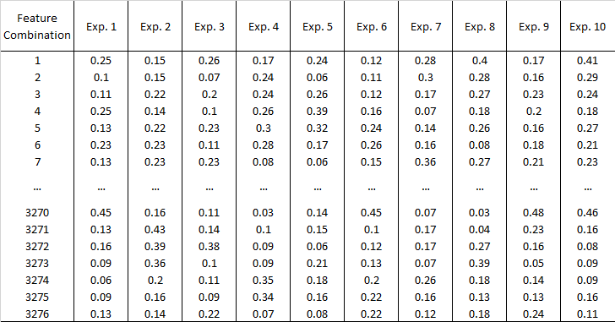



Spring 2017 | COSC 4570| UWYO
Limitations & Challenges
A Study of Cashier Behavior Based on Risk Classification Using Clustering Algorithms Amateur Data Miners
Time Constraint
K-Means did not work as expected
Many different clustering algorithms
Dataset have many both dependent and independent features
Results
GROUP MEMBERS: Archana Satyamurthy
Fiona Moss
Haojun Zhu
Thao Phung
emails: asatyamu@uwyo.edu
fmoss1@uwyo.edu
hzhu2@uwyo.edu
tphung@uwyo.edu
Clustering
Box-Cox Transformation
Motivation/Abstract
- The retail industry faces challenge of risky cashier behavior
Analyzing cashier data and identify the risk are necessary
The risk will be minimized
Retailers can make more profit, provide better customer service
Background
K-Means: - generates a specific number of disjoint, flat (non-hierarchical) clusters
- numerical, unsupervised, non-deterministic and iterative
2. Hierarchical: build a binary tree of the data that successively merges similar groups of points
3. Agglomerative: recursively merges the pair of clusters that minimally increases a given linkage distance
Affinity Propagation: concept of “message passing” between data points, not require the number of clusters.
Box-Cox Transformation
Fig3: Prediction Accuracy (%) of Different Algorithms Using All 28 Features
Fig1: Distribution of the Total Risk Factor on the Original Scale
Project Summary & Major Tasks
Safeway data, cashier risk report
Transform, normalize the dataset
Cluster the data using various different clustering algorithms
Two approaches:
Apply 4 clustering algorithms to 10 regions and observe which clustering algorithms provides meaningful clusters
K-Means
Hierarchical
Agglomerative
Affinity Propagation
Apply K-Means and Affinity Propagation to each combination of two and three columns/features
- Find the most applicable algorithm to cluster the dataset
Fig4: K-Means Clustering on Combinations of 3 Features Experiments
Fig2: Distribution of the Total Risk Factor after Box-Cox Transformation
Conclusions & Future Work
Hierarchical and Agglomerative clustering algorithms give better results than K-Means and Affinity Propagation do.
Approach 2: poses a very high demand on the computing resources
- Understand the parameters that help in obtaining the clusters , i.e. what columns/features of the data could be responsible to achieve good clusters
[1]. Safeway. University of Wyoming Risk Reports. Feb. 2011. Raw data. N.p.
[2]. Safeway-Albertson-Cashier Risk Report Documentation. Rep. N.p.: Sysrepublic, 2011. Print.
[3] ”Scikit-learn.” Scikit-learn: machine learning in Python scikit-learn 0.18.1 docu- mentation.
N.p., n.d. Web. 1 Apr. 2017.
Acknowledgement: Dr. Mike Borowczak
This poster made possible by:
UWYO College of Engineering & Applied Science, UWYO Computer Science Department, and UWYO CEDAR.

